Slide 1










Video Game Sales Analysis
November 24th, 2025
Kenneth Bathelemy
OIM 7502 Fall 2025

Slide 2



Agenda
Introduction to Project
Why Seaborn?
Dataset Summary
Sales Insights Example
Critic and User Score Correlations
Conclusion

Slide 3
Introduction
Introduction
Analyzes 19,000+ video games from Kaggle dataset
Explores relationships between ratings, sales, and platforms
Demonstrates Seaborn's visualization capabilities for data science
Shows integration between Seaborn and Matplotlib for publication-quality graphics
Key Questions:
Do highly-rated games sell more?
How do critics and users differ in their ratings?
Which platforms and publishers dominate the market?

Slide 4





Why Seaborn?
Plus tip:
Highlight specific examples of Seaborn plots your audience would find useful for their data analysis projects.
Seaborn
Key Advantages for Data Scientists
Common Plot Types We'll See Today
countplot, barplot → Categorical comparisons
histplot, kdeplot → Distributions
scatterplot, regplot → Relationships
heatmap → Correlations
Statistical visualization built-in (distributions, correlations, trends)
Minimal code for professional-looking plots
Handles complex multi-variable relationships effortlessly
Built on Matplotlib: combine ease with customization power
Excellent for data analysis and data storytelling
Perfect for: Quick exploration AND presentation-ready visuals

Slide 5
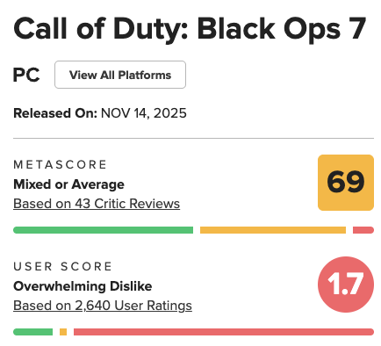
Dataset Overview
Dataset
Source & Scope
Data Quality & Limitations
Kaggle Video Game Sales dataset
19,600 games (1977-2020)
Key Variables: Platform, Publisher, Critic_Score, User_Score, Total_Shipped, Released Year
Critic scores: ~10,000 games (51%)
User scores: ~2,200 games (11%)
Physical sales only - missing digital distribution
Filtered to complete records for meaningful analysis

Slide 6

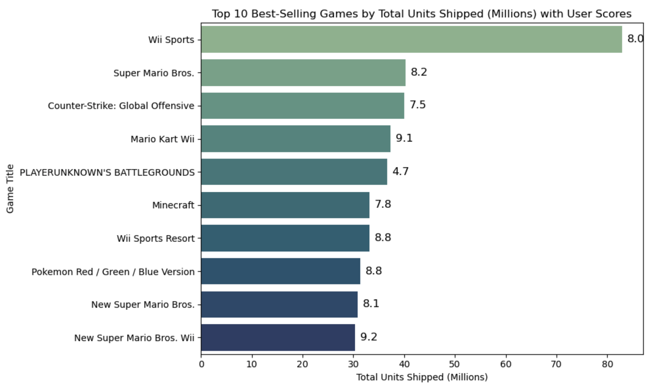
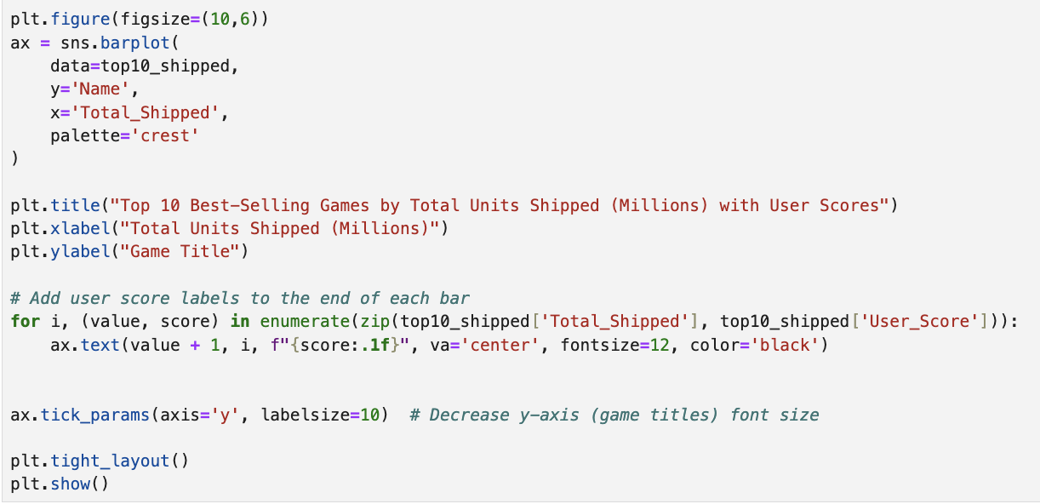

Best-Selling Games
Sales Insights
Key Findings:
Wii Sports, Super Mario Bros., and CS:GO lead in shipments
Best-sellers ≠ highest-rated (Wii Sports: 82.9M units, 8.0 user score)
Demonstrates Seaborn + Matplotlib integration

Slide 7

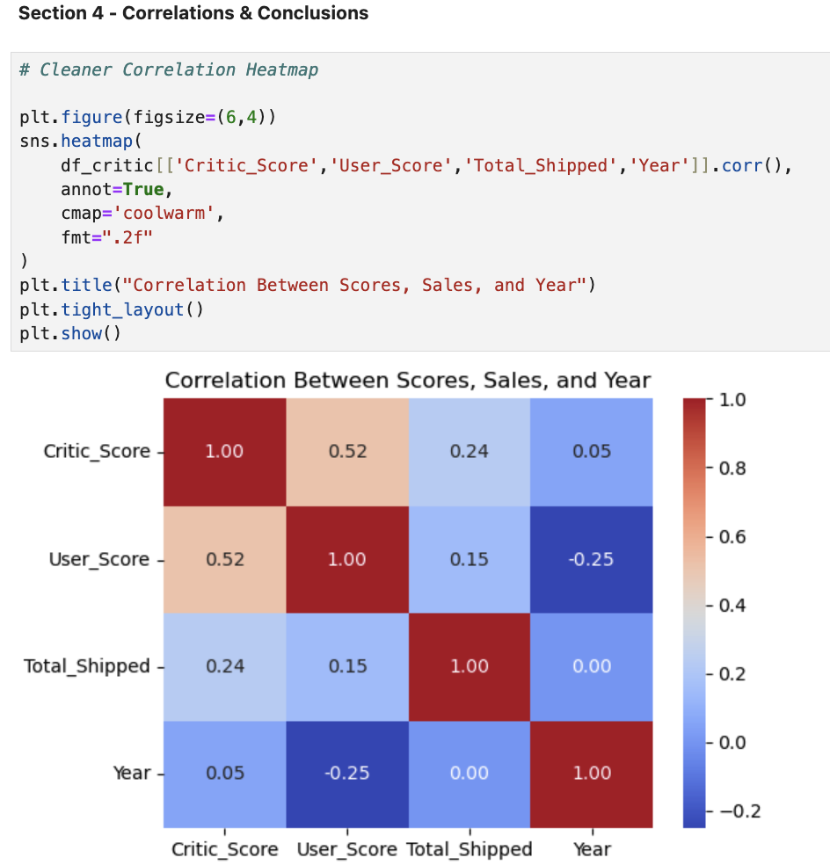
Analysis
Critic and User Score Correlations
Correlation Heatmap Insights
Critic scores have a weak positive relationship with total shipments (r = 0.24)
User scores show an even weaker correlation (r = 0.15)
Critics and users moderately agree with each other (r = 0.52)
Implications
This indicates ratings are not strong predictors of sales
Marketing, brand, and accessibility drive sales more than quality

Slide 8
Conclusion
Conclusion
What I Discovered
Platform choice matters - DS/PS2 had most games, but PS2 led in sales
Quality ≠ Sales - Best-sellers often have average ratings
Critics and users moderately agree (r = 0.52)
Sales driven by marketing and brand, not just ratings
Why Seaborn for Data Science?
✓ Fast exploratory analysis with minimal code
✓ Statistical visualizations built-in (KDE, regression, correlations)
✓ Combines with Matplotlib for publication-quality output
✓ Ideal for storytelling with data
Bottom Line
Seaborn = Speed + Clarity + Professional Results

Slide 9
Thank You
Coding Part :)

Slide 10
APPENDIX

Slide 11









REUSABLE GRAPHICS FOR YOUR PRESENTATIONS + SLIDES
ICONS BY MARY AMATO

Slide 12
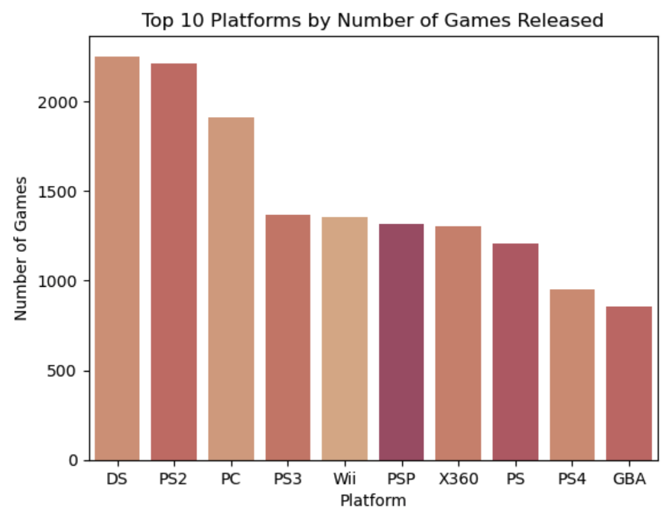
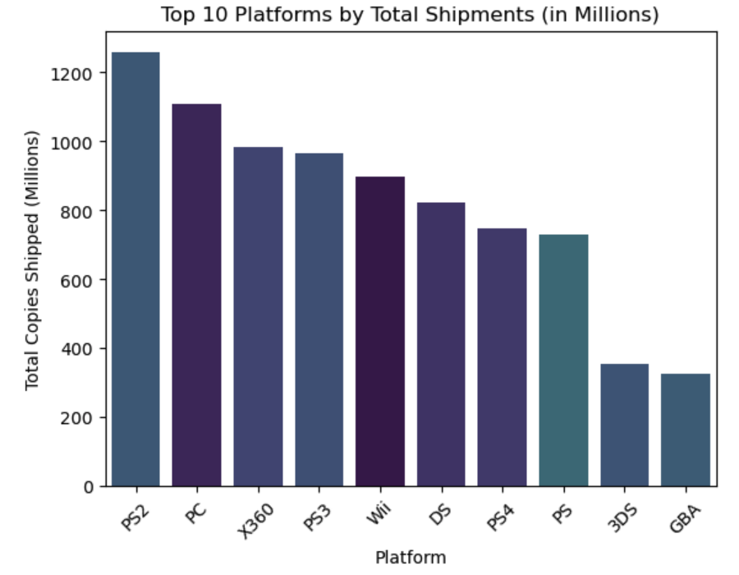
Volume & Sales
Plus tip:
Customize by adding recent platform sales data to show market trends over time.
Platforms
Top Platforms by Game Count
Top Platforms by Total Shipments
DS and PS2 have the highest number of game titles released.
These platforms dominate the volume metric in the dataset.
High title count indicates platform popularity and developer focus.
PS2 leads in total game units shipped, followed by PC and Xbox 360.
Shipment volume reflects commercial success beyond just game quantity.
Highlights platforms with strong market penetration and sales performance.

Slide 13
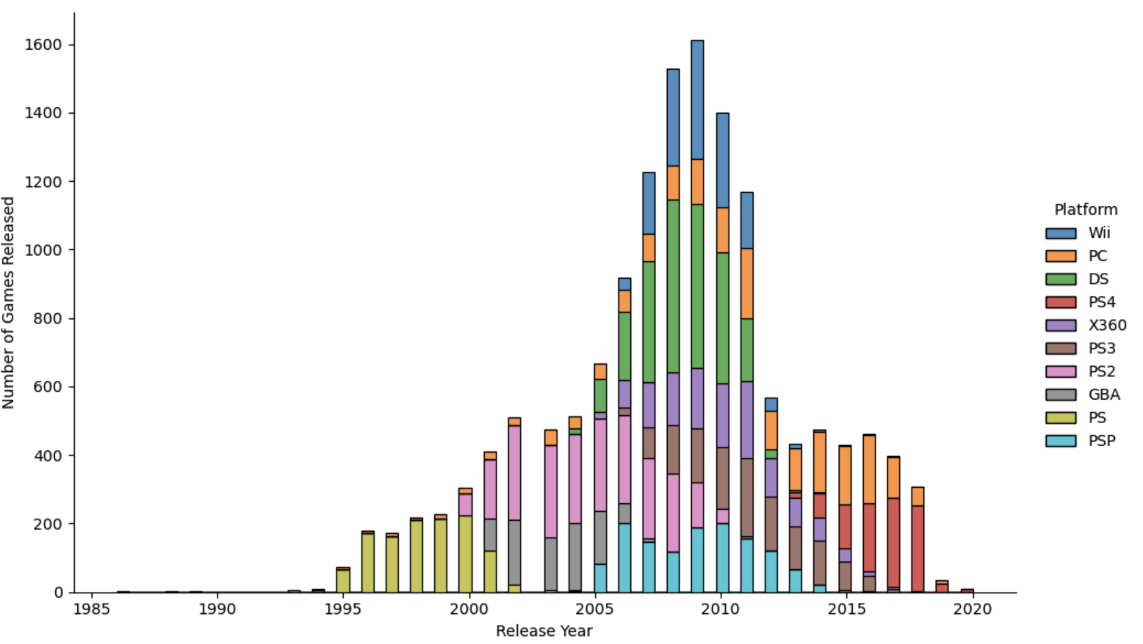
Release Trends
Plus tip:
Customize this slide by including specific platform names or trends relevant to your audience for greater impact.
Platforms
Platform Release Trends
Initial plot including all platforms was cluttered and hard to interpret
Filtered dataset to only the Top 10 platforms for clearer focus and better readability
Utilized Seaborn’s displot function, which provides automatic layering and smooth density estimation
Applied the 'tab10' color palette ensuring consistent, color-coded mapping in the legend for easy platform identification

Slide 14
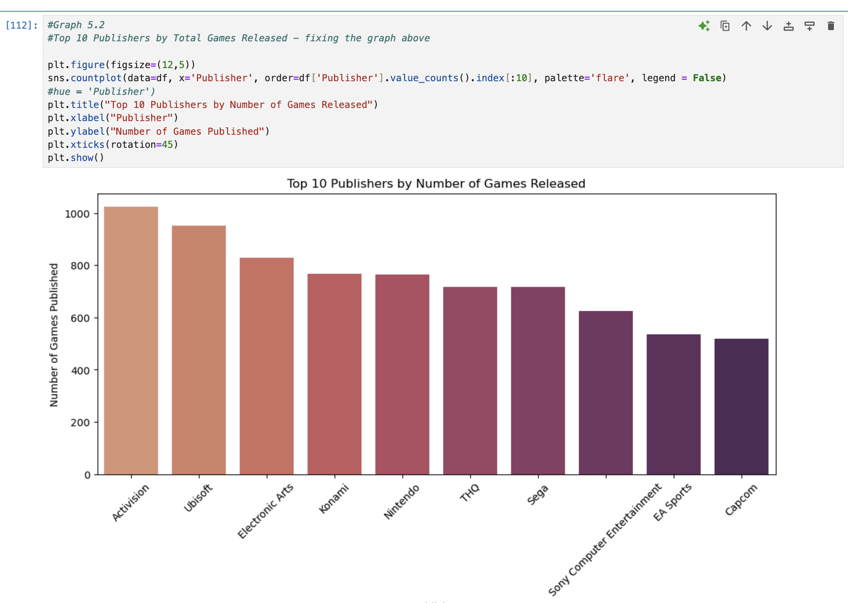
Publishers
Top Publishers by Count
Activision, EA, and Ubisoft are the most prolific publishers by game count.
These publishers dominate release volume across multiple gaming platforms.
High output reflects strong market presence and production capacity.
Barplots effectively highlight differences in publisher activity.
Plus tip:
Customize by adding recent publisher data or regional performance insights to increase relevance.

Slide 15
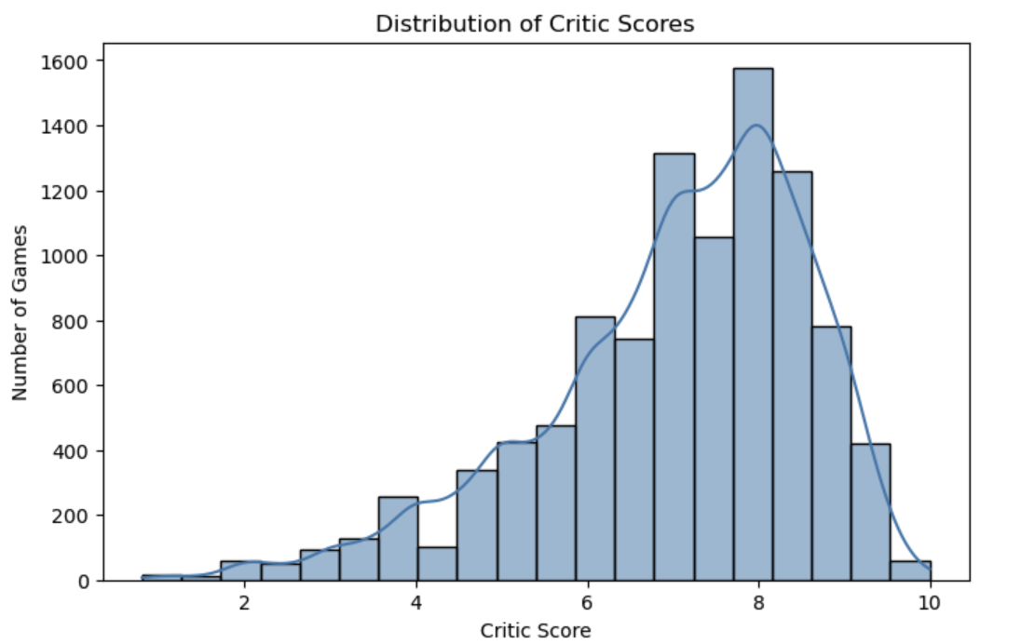
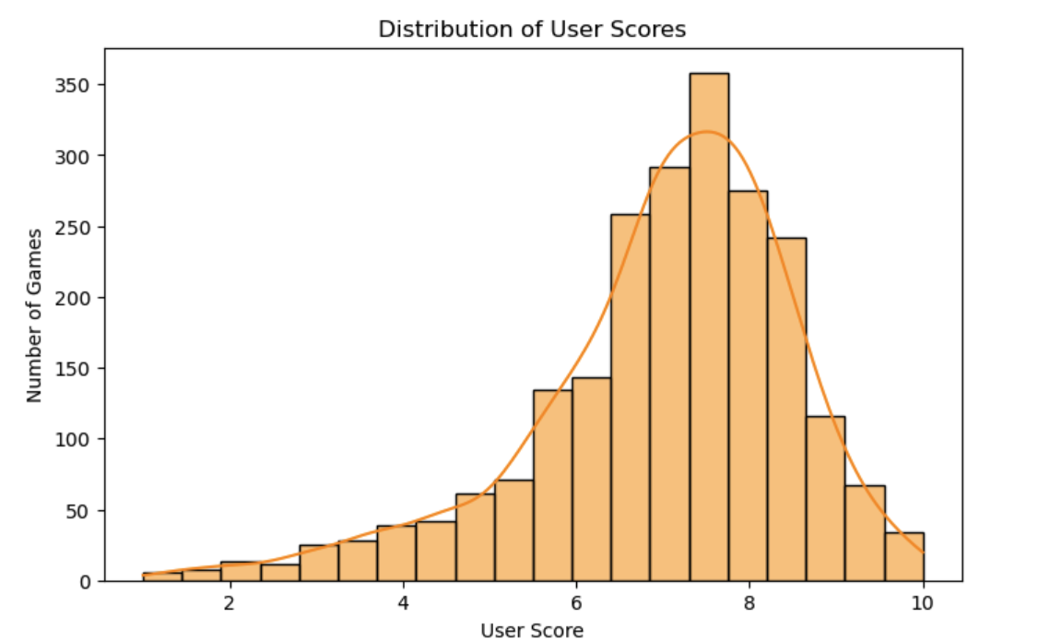
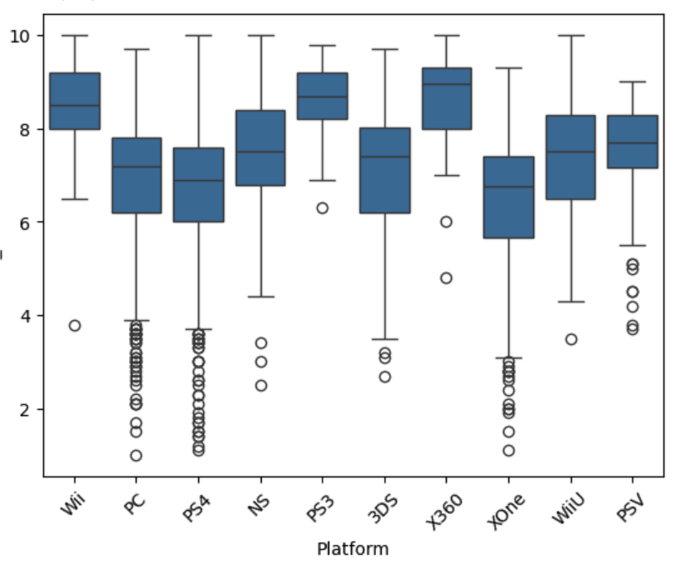
Score Insights
Plus tip:
Use platform logos or icons in the boxplot section to help the audience quickly identify each platform.
Analysis
Critic Score Distribution
User Score Variability
Boxplot by Platform
Critic scores form a bell-shaped curve centered near 8, indicating consistent critical reception.
User scores show greater variability and a lower average than critics, reflecting diverse player opinions.
Boxplots display median, interquartile range, whiskers, and outliers; PC platform shows the widest score range.

